Slide 1

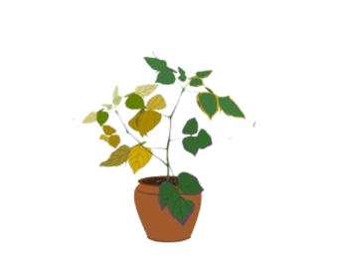
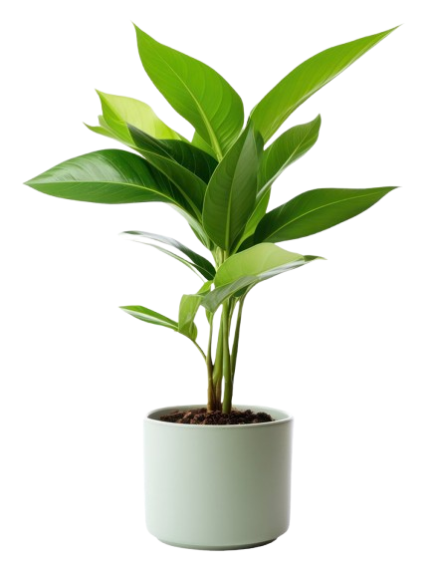
Plant Disease Detection and Remedy Suggestion for Home Based Farming
Guided By
Ms.K.Deekshana M.Sc,
Assistant Professor
Department of Computer Science
Kongunadu Arts and Science College (Autonomous)
Presented By
Mohammed Arshad Jawahir
(221cs019)
Sakthi Vignesh (221cs033)
3rd B.sc Computer Science

Slide 2


Abstract
Home-based farming is gaining popularity among individuals growing vegetables for personal consumption.Unlike farmers, home growers often lack knowledge about identifying plant diseases and their remedies.This project addresses this issue by providing an application that allows users to upload photos of diseased plants.Using image processing and machine learning, the app identifies the disease and provides remedies, empowering home growers to maintain healthy plants and sustainable food production.

Slide 3


Existing System :
Currently, there is limited technology available for home gardeners to detect plant diseases and identify remedies. Traditional methods include manually observing plants for visible signs of diseases.
Gardeners rely on internet searches, books, or advice from experienced individuals to identify plant issues.
General apps available for farmers focus on large-scale agriculture,
No real-time plant disease detection system tailored for small-scale, house-based gardening.

Slide 4
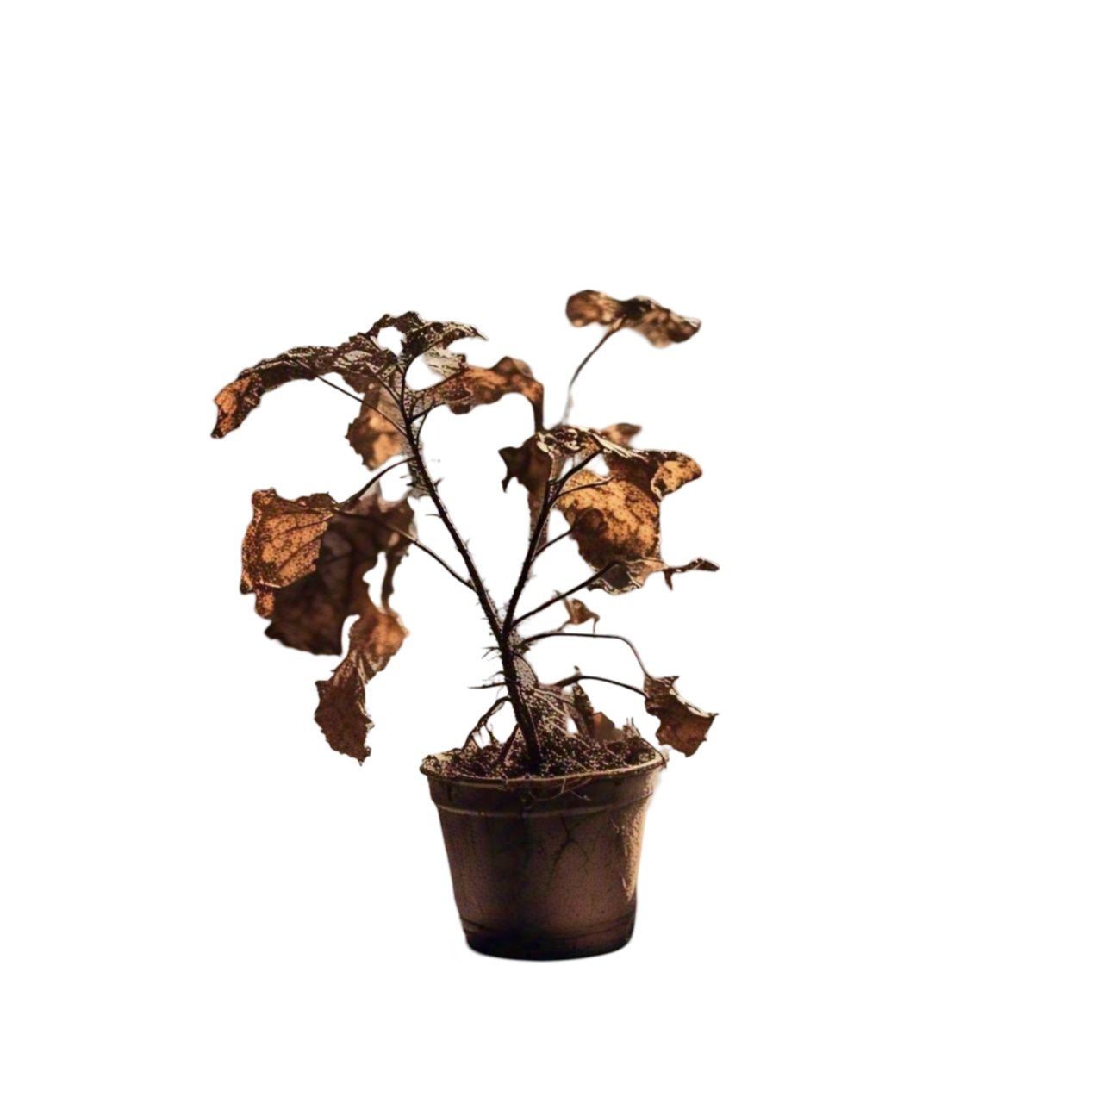
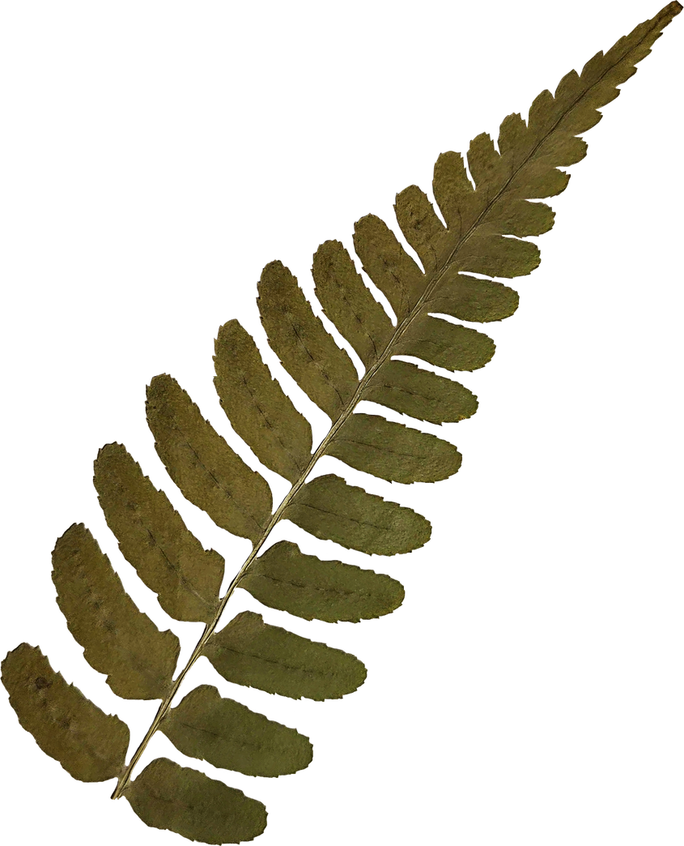
Existing System [Disadvantages]:
Lack of Awareness: Home growers often rely on trial-and-error methods or internet searches for plant disease identification, leading to unreliable results.
Dependency on Experts: Professional agricultural advice is not always accessible to people engaging in home-based farming.
Time-Consuming Processes: Diagnosing a plant disease manually or through conventional methods is time-intensive and often inaccurate.
Limited Tools: No user-friendly systems specifically cater to home-based farming needs for disease detection and remedies.

Slide 5

Proposed System
1.Instant Diagnosis: The app provides quick and accurate identification of plant diseases using advanced machine learning algorithms.
2.Ease of Use: Designed with a simple interface, it caters specifically to non-experts engaging in home-based farming.
3.Custom Remedies: Provides actionable and easy-to-follow remedies tailored for common home-grown vegetables and plants.
4.Accessible Technology: Leverages smartphone cameras and lightweight web apps to make plant health monitoring affordable and widely available.

Slide 6

Module
User Interface
Image Upload
Disease Detection
Remedy Suggestion

Slide 7




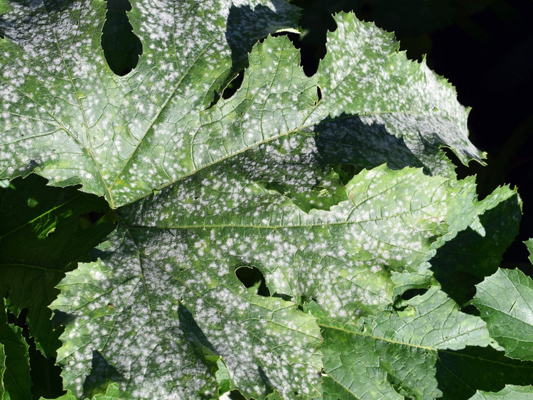

Module Descriptions
Image Upload module
Image
Uploaded
• Users can upload a plant image from their device.
• The system accepts common image formats like JPG and PNG.
• The uploaded image is sent for preprocessing.
Disease Detection module
• The model detects and classifies the disease based on its database.
• If no disease is found, the system informs the user that the plant is healthy.
• The detection results are displayed with a confidence score.
Powdery mildew
Remedy Suggestion module
• Based on the detected disease, the system suggests appropriate solutions.
• Remedies may include:
• Organic and chemical treatments
Potassium
bicarbonate

Slide 8

Tech Stake used
1.CNN(Resnet-50)
2. Python (VS Code, Jupyter Notebook)
3.MySql

Slide 9
CNN (Convolutional Neural Networks)
1. What is CNN?
A Convolutional Neural Network (CNN) is a type of deep learning model specifically designed for image classification, object detection, and pattern recognition.
✓ CNN is mainly used in computer vision tasks, including:
* Plant disease detection
* Image analysis
CNN automatically extracts important features from images (like texture, edges, and color patterns) without needing manual feature selection like traditional machine learning.

Slide 10
ResNet-50
ResNet-50 is a 50-layer deep Convolutional Neural Network (CNN) introduced by Microsoft Research in 2015.
Builds on CNNs by using residual learning with skip connections to solve training challenges in deep networks.
Offers high accuracy (5.25% top-5 error on ImageNet) and automatically extracts features like texture and color.
ResNet-50 is a 50-layer deep CNN that uses skip connections to improve training and achieve high accuracy for tasks like plant disease detection.

Slide 11
Data flow diagram
User uploads plant leaf image
Image preprocess
(Resize)
Model Prediction
(ResNet50
Confidence Score
Display Results (Disease,
Remedies)
Fetch Remedy from data dictionary
Disease
Class

Slide 12
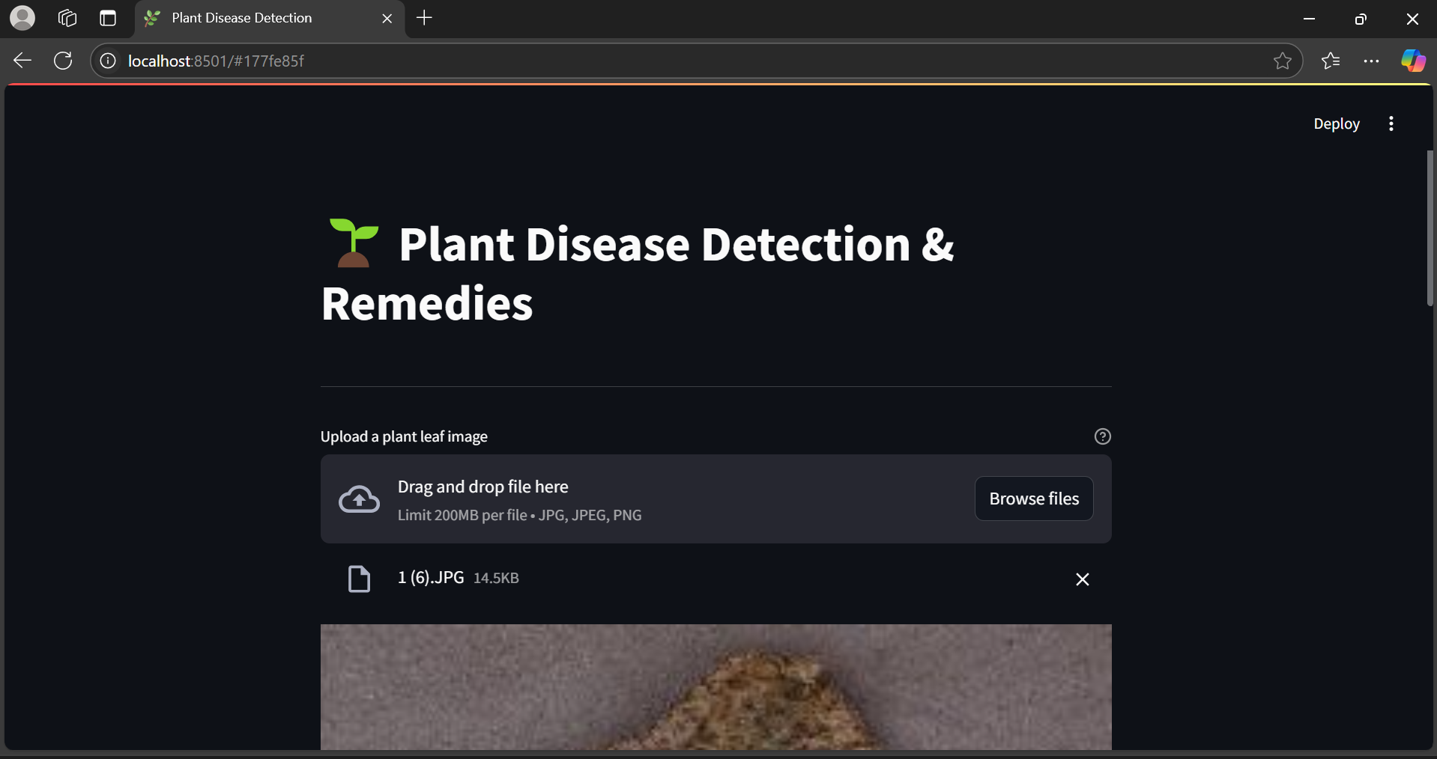
Input Design

Slide 13
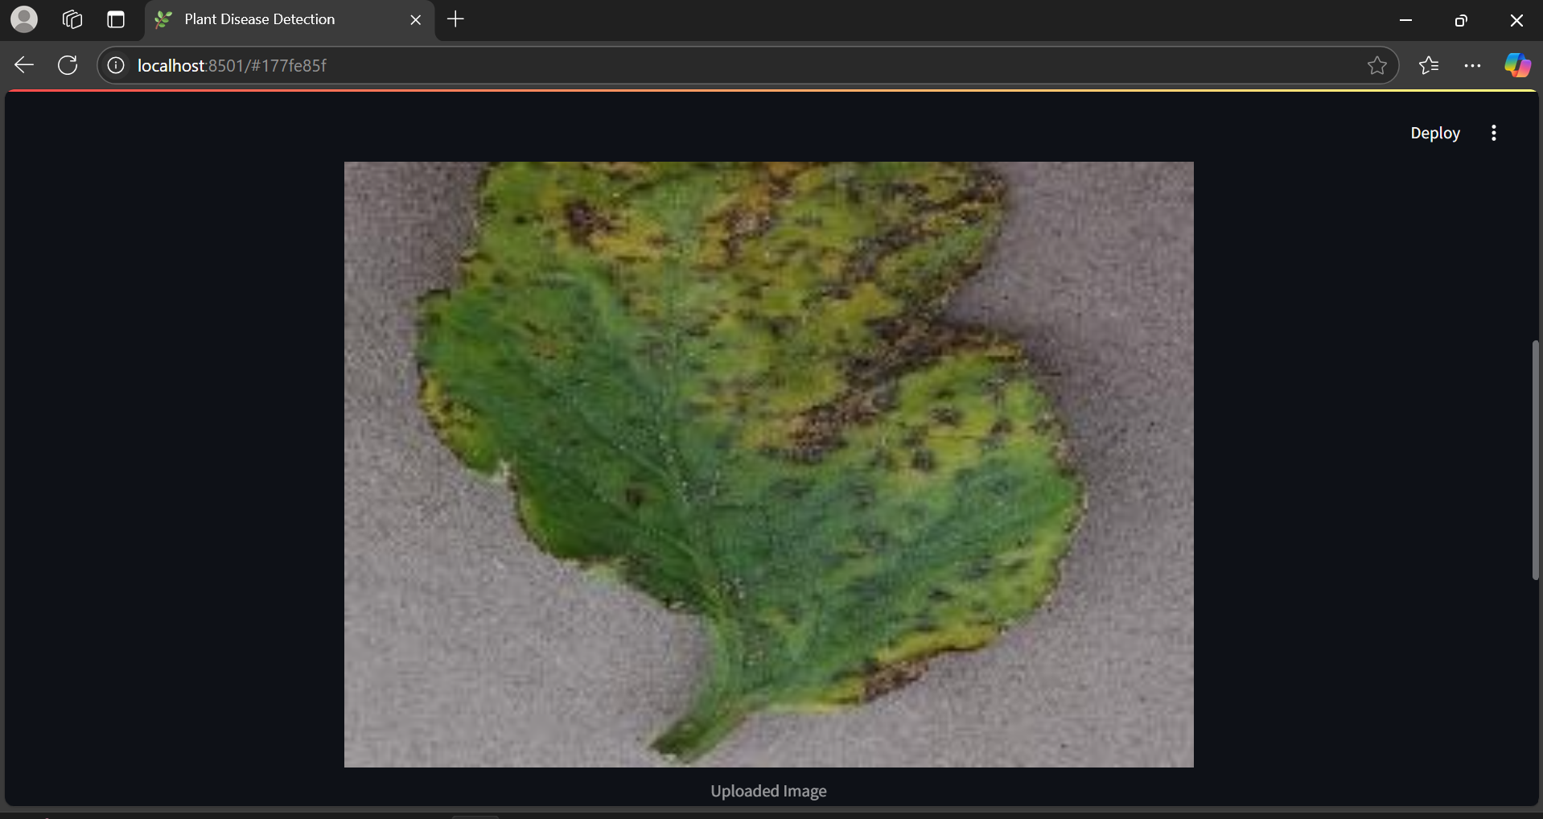

Slide 14
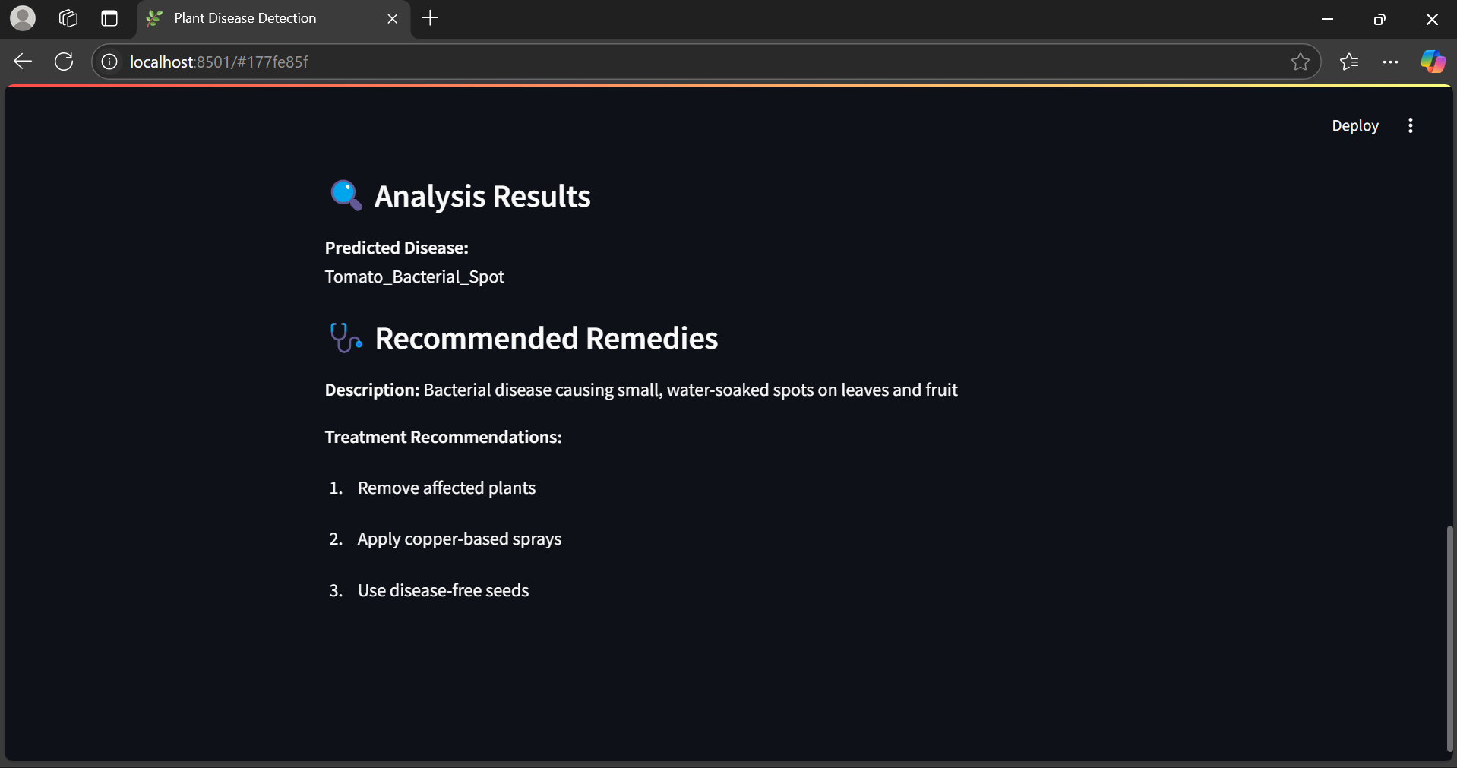
Output Design

Slide 15
System specification
Hardware Configuration
Software Configuration
Processor :Intel core i7
Operating System :Windows 11
Ram :8GB Ram
IDE(software) :PyCharm
2021.3.1
Storage :512GB
Keyboard :Standard 102 key
Front End :Python 3.8
Mouse :3 Buttons

Slide 16

Bibliography
Research Paper: Application of Machine Learning in Plant Disease Detection and Diagnosis: Discusses the advantages of machine learning methods for plant disease detection.
https://link.springer.com/chapter/10 .1007/978-981-97-6160-9_7
TensorFlow Documentation: Resources on machine learning models and implementation.
https://www.tensorflow.org/
OpenCV Documentation: Detailed information on image processing techniques using OpenCV.
https://docs.opencv.org/
Kaggle Plant Disease Dataset: A dataset for training and testing plant disease detection models.
https://www.kaggle.com/datasets /emmarex/plantdisease
Streamlit Documentation:
Comprehensive guide on building web applications with Streamlit.
https://docs.streamlit.io

Slide 17

Conclusion
User-Friendly Application: Developed a straightforward interface tailored for home-based gardeners to easily identify plant diseases.
Accurate Disease Identification: Implemented a machine learning model to reliably classify various plant diseases from images.
Actionable Remedies: Provided users with practical solutions and preventive measures for identified plant diseases.
Empowering Home Gardeners: Equipped individuals with limited agricultural knowledge to maintain healthy plants and ensure sustainable home farming.

Slide 18


Thank you

